Slide 1
Twitter Sentiment Analysis
2022 AI tweets
Liangyuwang

Slide 2
Background & Objective
Background
AI became a hot topic in 2022 because of introduction of Large Language Models and diffusion models
Some people were positive towards this development, while others were negative
Objective
Scrap #AI tweets
Perform sentiment analysis
Present findings

Slide 3
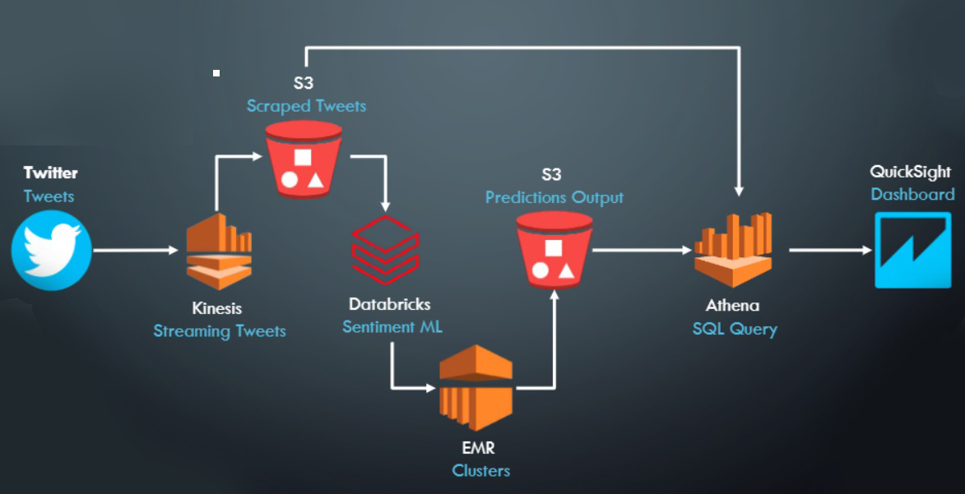
Data

Slide 4
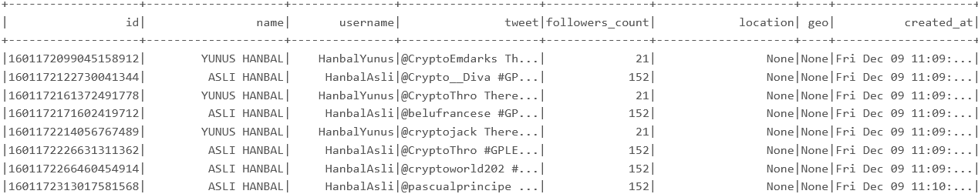
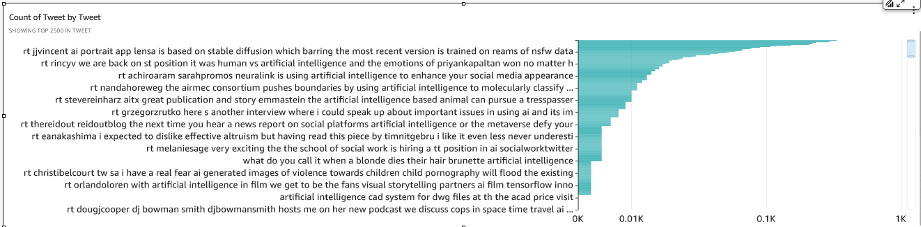
Tweet Analysis

Slide 5
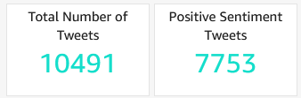
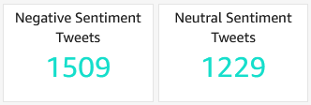
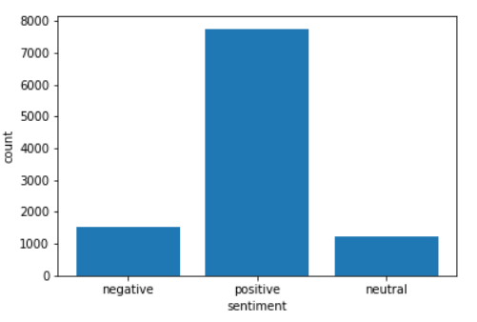
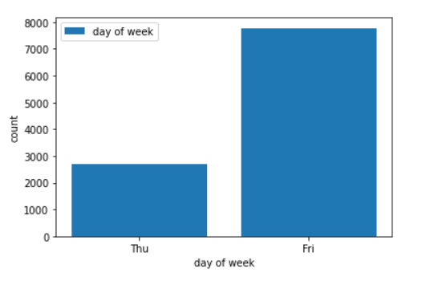
Tweet Analysis

Slide 6
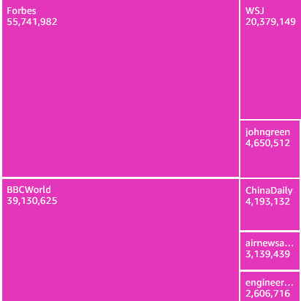

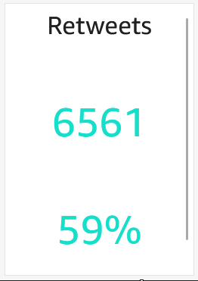
Tweet Analysis

Slide 7
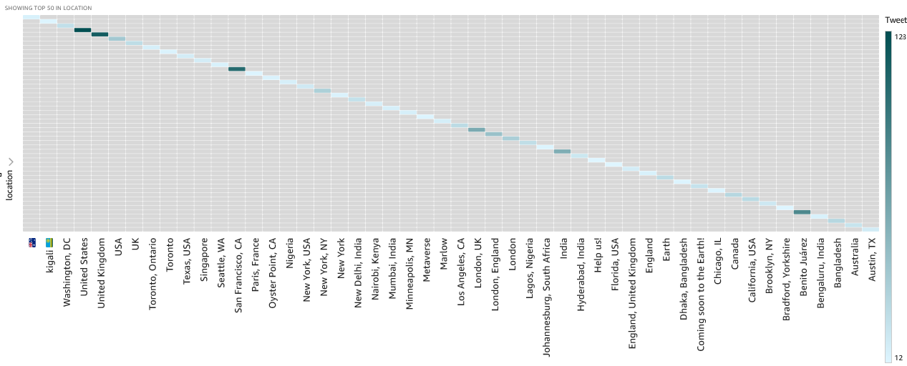
Tweet Analysis

Slide 8
Tweet Analysis
Logistic Regression
Accuracy Score: 0.8977
ROC-AUC: 0.8976
Decision Tree
Accuracy Score: 0.7974 ROC-AUC: 0.7426

Slide 9
Conclusion
Challenges
Databricks community edition cluster has 2 hours limit
Databricks community edition cluster is very slow when working with large data sets
59% of tweets are retweets
Conclusion
Most people are positive towards developments in AI
Logistic regression is better than Decision Tree model
Logistic Regression model accuracy is 90%

